Slide 1
Cyber-bullying: The Silent Killer
South eastern kenya university (SEKU)
Public lecture
5th march, 2020
BY
Dr. makau mutua
Senior lecturer, department of computer science
Meru university of science & technology

Slide 2
Historical Perspective
Technological history dates back millions of years
Ancient technology: Fire, agriculture, irrigation, sailing e.t.c
Industrial Age: Manufacturing processes, Hand to machine – Standard of living, income levels, commercialized economies
Computer Revolution: Mainframe computers, Mini-computers, Micro-computers
Internet Transformation: ARPANET, TCP/IP (1974), HTML, Web 2.0, Social media, Web 3.0 …..
Internet of Things: Everything connected with everything – M2M communication powered by the Internet
Notes:
1 million years ago: Fire When humanity first used fire is still not definitively known, but, like the first tools, it was probably invented by an ancestor of Homo sapiens. Evidence of burnt material can be found in caves used by Homo erectus beginning about 1 million (and maybe even 1.5 million) years ago.
20,000 to 15,000 years ago: Neolithic Revolution During the Neolithic Period several key technologies arose together. Humans moved from getting their food by foraging to getting it through agriculture. People came together in larger groups. Clay was used for pottery and bricks. Clothing began to be made of woven fabrics. The wheel was also likely invented at this time.
6000 BCE: Irrigation The first irrigation systems arose roughly simultaneously in the civilizations of the Tigris-Euphrates river valley in Mesopotamia and the Nile River valley in Egypt. Since irrigation requires an extensive amount of work, it shows a high level of social organization.
4000 BCE: Sailing The first sailing ships were used on the Nile River. Since the Nile does not allow as much space for free sailing as the ocean, these ships also had oars for navigation.
1200 BCE: Iron About this time, the production of iron became widespread as that metal supplanted bronze. Iron was much more abundant than copper and tin, the two metals that make up bronze, and thus put metal tools into more hands than ever before.
850 CE: Gunpowder Alchemists in China invented gunpowder as a result of their search for life-extending elixirs. It was used to propel rockets attached to arrows. The knowledge of gunpowder spread to Europe in the 13th century.
950: Windmill Nearly 5,000 years after the first sailing ships, the wind was first used to operate a mill. The first windmills were in Persia. They were horizontal windmills in which the blades were set on a vertical shaft. Later, European windmills were of the vertical type. It has been speculated that the windmill may have been invented independently in Persia and in Europe.
1044: Compass The first definitive mention of a magnetic compass dates from a Chinese book finished in 1044. It describes how soldiers found their way by using a fish-shaped piece of magnetized iron floating in a bowl of water when the sky was too cloudy to see the stars.
1250–1300: Mechanical clock Hourglass and water clocks had been around for centuries, but the first mechanical clocks began to appear in Europe toward the end of the 13th century and were used in cathedrals to mark the time when services would be held.
1455: Printing Johannes Gutenberg completed the printing of the Bible, which was the first book printed in the West using movable type. Gutenberg’s printing press led to an information explosion in Europe.
1765: Steam engine James Watt improved the Newcomen steam engine by adding a condenser that turned the steam back into liquid water. This condenser was separate from the cylinder that moved the piston, which meant that the engine was much more efficient. The steam engine became one of the most important inventions of the Industrial Revolution.
1804: Railways English engineer Richard Trevithick improved James Watt’s steam engine and used it for transport. He built the first railway locomotive at an ironworks in Wales.
1807: Steamboat Robert Fulton put the steam engine on water. His steamboat that was eventually called the Clermont took 32 hours to go up the Hudson River from New York City to Albany. Sailing ships took four days.
1826/27: Photography In the early 1820s, Nicéphore Niépce became interested in using a light-sensitive solution to make copies of lithographs onto glass, zinc, and finally a pewter plate. He then had the great idea to use his solution to make a copy of an image in a camera obscura (a room or box with a small hole in one end through which an image of the outside is projected). In 1826 or 1827, he made an eight-hour-long exposure of the courtyard of his house, the first known photograph.
1831: Reaper For thousands of years, harvesting crops was very labour-intensive. That changed with Cyrus McCormick’s invention of the mechanical reaper. The earliest reaper had some mechanical problems, but later versions spread throughout the world.
1844: Telegraph Samuel Morse was a successful painter who became interested in the possibility of an electric telegraph in the 1830s. He patented a prototype in 1837. In 1844 he sent the first message over the first long-distance telegraph line, which stretched between Washington, D.C., and Baltimore. The message: “What hath God wrought.”
1876: Telephone Once it was possible to send information through a wire in the form of dots and dashes, the next step was actual voice communication. Alexander Graham Bell made the first telephone call, on March 10, 1876, when he asked his assistant Tom Watson to come to him: “Mr Watson—come here—I want to see you.”
1876: Internal-combustion engine German engineer Nikolaus Otto built an engine that, unlike the steam engine, used the burning of fuel inside the engine to move a piston. This type of engine would later be used to power automobiles.
1879: Electric light After thousands of trials, American inventor Thomas Edison got a carbon-filament light bulb to burn for 13½ hours. Edison and others in his laboratory were also working on an electrical power distribution system to light homes and businesses, and in 1882 the Edison Electric Illuminating Company opened the first power plant.
1885: Automobile The internal-combustion engine improved, becoming smaller and more efficient. Karl Benz used a one-cylinder engine to power the first modern automobile, a three-wheeled car that he drove around a track. However, the automobile did not make a commercial splash until 1888, when his wife, Bertha, exasperated with Karl’s slow methodical pace, took an automobile without his knowledge on a 64-mile trip to see her mother.
1901: Radio Guglielmo Marconi had been experimenting with radio since 1894 and was sending transmissions over longer and longer distances. In 1901 his reported transmission of the Morse code letter S across the Atlantic from Cornwall to Newfoundland excited the world.
1903: Airplane On December 17 Orville Wright made the first airplane flight, of 120 feet, near Kitty Hawk, North Carolina. He and his brother Wilbur made four flights that day. On the last, Wilbur flew 852 feet.
1926: Rocketry As a young boy in the late 1890s, Robert Goddard was inspired by H.G. Wells’s The War of the Worlds and the possibilities of space travel. As a middle-aged man in the mid-1920s, he achieved the first test flight of a liquid-fueled rocket, from his aunt’s farm in Auburn, Massachusetts. The rocket flew 12.5 meters (41 feet) in the air.
1927: Television After the development of radio, the transmission of an image was the next logical step. Early television used a mechanical disk to scan an image. As a teenager in Utah, Philo T. Farnsworth became convinced that a mechanical system would not be able to scan and assemble images multiple times a second. Only an electronic system would do that. In 1922 the 16-year-old Farnsworth worked out a plan for such a system, but it wasn’t until 1927 that he made the first electronic television transmission, a horizontal line.
1937: Computer Iowa State mathematician and physicist John Atanasoff designed the first electronic digital computer. It would use binary numbers (base 2, in which all numbers are expressed with the digits 0 and 1), and its data would be stored in capacitors. In 1939 he and his student Clifford Berry began building the Atanasoff-Berry Computer (ABC).
1942: Nuclear power As part of the Manhattan Project to build the first atomic bomb, it was necessary to understand nuclear reactions in detail. On December 2 underneath the football stands at the University of Chicago, a team of physicists led by Enrico Fermi used uranium to produce the first self-sustaining chain reaction.
1947: Transistor On December 23 Bell Labs engineers John Bardeen, Walter Brattain, and William Shockley gave the first public demonstration of the transistor, an electrical component that could control, amplify, and generate current. The transistor was much smaller and used less power than vacuum tubes and ushered in an era of cheap small electronic devices.
1957: Spaceflight The Soviet Union surprised the world on October 4, when it launched the first artificial satellite, Sputnik 1, a small 83.6-kg (184.3-pound) metal sphere. The space race began between the Soviet Union and the United States, opening up a new front in the Cold War.
1974: Personal computer The first computers that emerged after World War II were gigantic, but, with advances in technology, especially in putting many transistors on a semiconductor chip, computers became both smaller and more powerful. Finally, they became small enough for home use. The first such personal computer was the Altair, which was soon supplanted in 1977 by the Apple II, the TRS-80, and the Commodore PET.
1974: Internet Vinton Cerf and Robert Kahn produced the TCP/IP (Transmission Control Protocol/Internet Protocol), which describes how data can be broken down into smaller pieces called packets and how these packets can be transmitted to the right destination. TCP/IP became the basis for how data is transmitted over the Internet.
2012: CRISPR American biochemist Jennifer Doudna and French microbiologist Emmanuelle Charpentier developed CRISPR-Cas9, a method for editing genes—that is, making changes to DNA sequences. Gene editing has the potential to treat many diseases but also opens up the ethical gray area of creating designer humans.
2017: Artificial intelligence The team behind the AlphaGo artificial intelligence program announced that it had become the world’s best go player. Go is a game with very simple rules but many possible positions. The previous year AlphaGo had defeated the great player Lee Sedol in a match 4–1. AlphaGo then played itself and, through continual improvement, was able to defeat the version that had defeated Lee, 100–0. Through machine learning, AlphaGo had become better at the game than any human.

Slide 3
The Internet

Slide 4
Cybercrime & Security
ITU Definition:
“Cybersecurity is the collection of tools, policies, security concepts, security safeguards, guidelines, risk management approaches, actions, training, best practices, assurance and technologies that can be used to protect the cyber environment and organization and user’s assets.”
What about emotions, social violence etc?
No security without crime!
Cybercrime - criminal activities carried out by means of computers or the Internet.

Slide 5
Cybercrime
Four Technical Categories:
Cyber-deceptions: Identity theft, fraud, piracy
Cyber-pornography: Spreading obscene materials
Cyber-violence: Cyber bullying
Cyber Trespass: Hacktivism, viruses, DoS, DDoS
{Email login, Trojans, Apps, Pirated Software}
Three Legal Categories:
Crime against Property
Crime against Organization
Crime against people
{Challenge - Evidence}
Notes:
Cyberpornography is the act of using cyberspace to create, display, distribute, import, or publish pornography or obscene materials, especially materials depicting children engaged in sexual acts with adults. Cyberpornography is a criminal offense, classified as causing harm to persons

Slide 6
Bullying
As old as human race
Really?
- Bullying the bully?
Notes:
The high school days – beating

Slide 7
My Motivation
“Hi Sir, my name is Atuti* taking course BBI*. I wish to inform you that I’ll not be able to complete my sem. I feel useless and helpless. I can’t face my classmates . Sth is wrong and I can’t face it. I don’t know what to do. I can’t live in this evil world. Bye mwalimu – am sorry to dissappoint u”
Current research suggests that suicide ideation and attempts among adolescents have nearly doubled since 2008 (Plemmons et al, 2018), making suicide the 2nd leading cause of death for individuals 10-34 years of age (CDC, 2017)

Slide 8
Cyber Bullying

Slide 9
Cyber Bullying
Def.: The use of the Internet and/or mobile technology to harass, intimidate, or cause harm to another person.
Repeatedly and intentionally harasses, mistreats, or makes fun of another person online or while using cell phones or other electronic devices
Not a new social issue but propelled by;
Technological advancements
Increasing online social forums
Large population ~ Great impact
Sedentary lifestyle
Anonymity ~Pseudonyms
From school environment to social platforms.
Notes:
A sedentary lifestyle is a type of lifestyle involving little or no physical activity. A person living a sedentary lifestyle is often sitting or lying down while engaged in an activity like reading, socializing, watching television, playing video games, or using a mobile phone/computer for much of the da

Slide 10
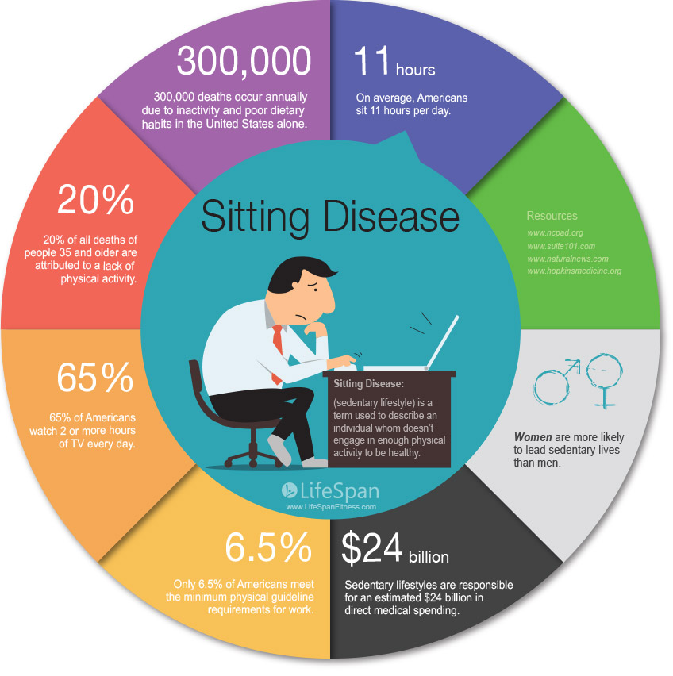
Sedentary Lifestyle
STATS
2 hours and 51 minutes per day on mobile device
22% of us check our phones every few minutes
51% of users look at it a few times per hour

Slide 11
Forms of Cyber Bullying
Cyber stalking
Cyber Bantering
Cyber Trolling
“Approximately 1 in 5 children and youth in the US experience a serious mental health concerns associated with trauma, social isolation, and bullying, yet only 20% of them receive the help they need” (CDC, 2019)
Kenya?? – Digital Penetration

Slide 12
Cyber Stalking
Technologically-based "attack" on one person who has been targeted for reasons of anger, revenge or control.
Forms include:
Harassment, embarrassment and humiliation of the victim
Ruining someone’s credit score
Harassing family, friends and employers to isolate the victim
Scare tactics to instil fear and more

Slide 13
Cyber Trolling
Trolling is when someone comments or responds to something you post, usually in a confrontational way that is designed to garner a strong, emotional reaction.
Forms include:
Grave digging
Political insults
Common in newsgroup, forum, chat room, or blog

Slide 14
Cyber Bantering
“It’s just banter.” -Playful chat

Slide 15
Sources of Cyber Bullying
Memes
K.O.T
Kilimani Mums and Dads
Buyers Beware
Whatsapp
Telegram
Instagram
Facebook

Slide 16
Victims of Cyber Bullying
Lynda Nyangweso: Trolled for her body
CJ David Maraga
Jimmy Gait
H.E. Uhuru Kenyatta
Kobi Kihara (NTV presenter)-#KobiCatChallenge
“I’m sorry to everyone who I mislead, forgive me. I should have thought twice perhaps and I guess it got away from me. And to my friends in the DM and on WhatsApp thanks for the lovely messages, I’m ok…really to the trolls and bullies…it’s ok! I can handle being an online punching bag, go for it,’’ she apologized after Kenyans trolled her immensely on social media.

Slide 17
Victims of Cyber Bullying

Slide 18
Effects of Cyber-bullying
Fear – The world knows
Low self esteem
Anxiety, stress and depression
Anger and Vengeance
Suicidal thoughts/Death: Targets of cyberbullying are at a greater risk than others of both self-harm and suicidal behaviors ~US (John et al, 2018)

Slide 19
Defense
Don’t fake
Block! Block! Block!
Log Out
Report Abuse to the police and social media sites. Many online platforms i.e. Twitter, YouTube, Facebook and Instagram have provisions to report persons engaged in cyber bullying
Share with close people
Quit if need be

Slide 20
Kenya
Section 27 of the Computer Misuse and Cybercrimes Act, 2018 provides the following in relation to what it terms as cyber harassment –
A person who, individually or with other persons, wilfully communicates, either directly or indirectly, with another person or anyone known to that person, commits an offence, if they know or ought to know that their conduct—
(a) is likely to cause those persons apprehension or fear of violence to them or damage or loss on that persons’ property; or (b) detrimentally affects that person; or (c) is in whole or part, of an indecent or grossly offensive nature and affects the person.

Slide 21
Kenya
(2) A person who commits an offence under subsection (1) is liable, on conviction, to a fine not exceeding twenty million shillings or to imprisonment for a term not exceeding ten years, or to both. (3) A person may apply to Court for an order compelling a person charged with an offence under subsection (1) to refrain from— (a) engaging or attempting to engage in; or (b) enlisting the help of another person to engage in, any communication complained of under subsection (1).

Slide 22
WAY FORWARD
Legislation (Computer Misuse and Cybercrimes Bill, 2018)
Research
Awareness
Care about others:
Think about what you post online -could these words be picked up the wrong way or cause upset? Is this photo suitable?
If you post something online and ‘comments’ or ‘chat’ becomes cruel, remove your posts so you are not part of a negative situation.
I always ask myself would I like this to be read about myself. It puts it into perspective and avoids any type of negativity online.
Always be careful online and remember that words don’t just hurt but can kill.

Slide 23
Cyber Bullying End Result

